Slide 1
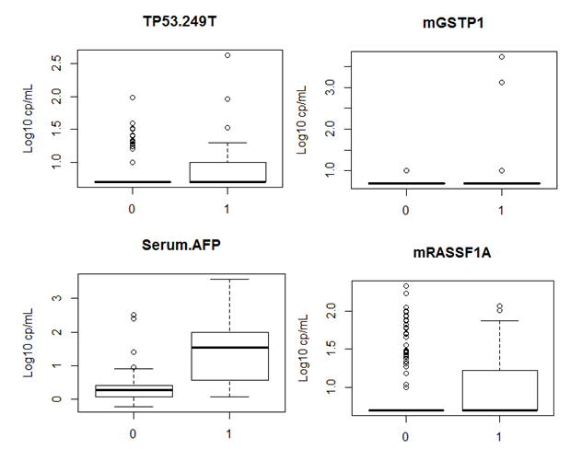
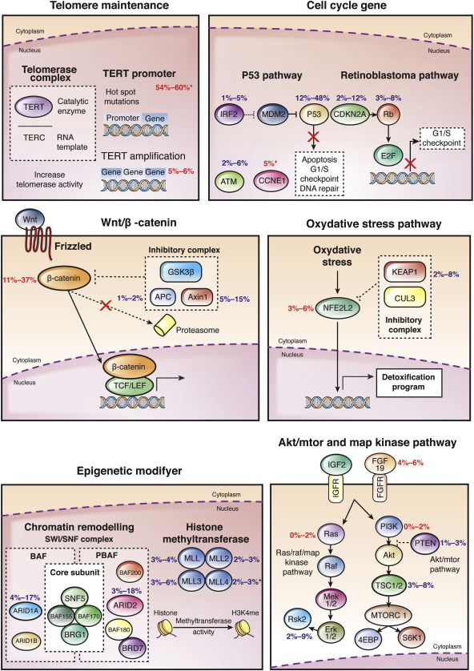
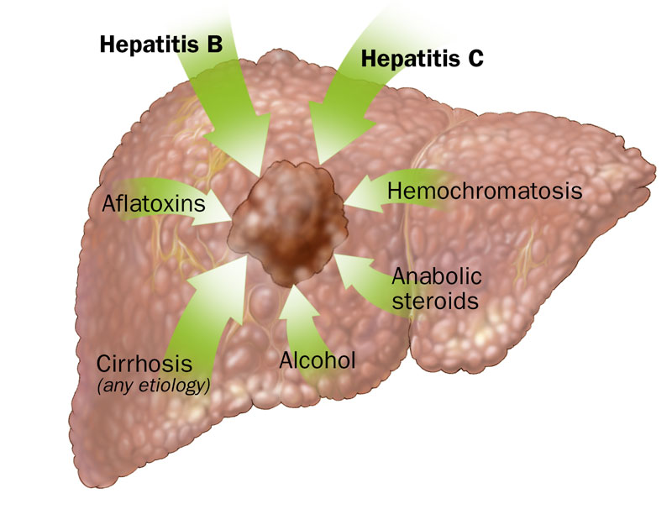
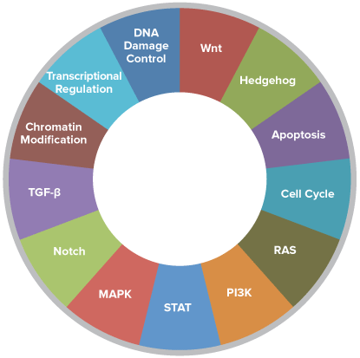
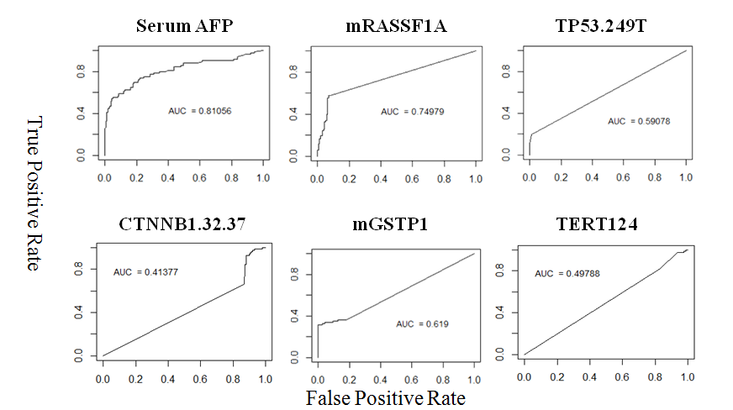
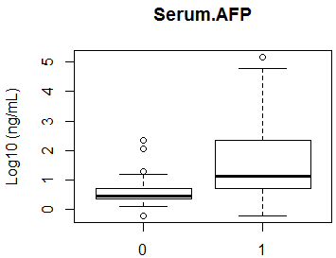
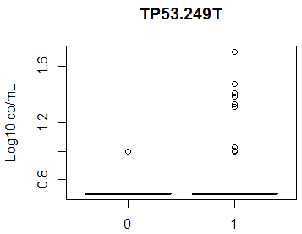
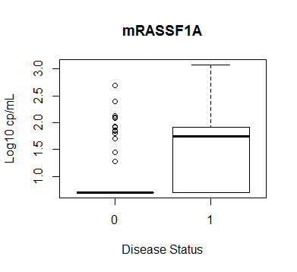
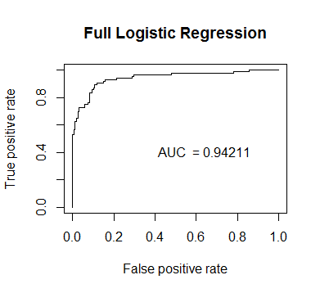
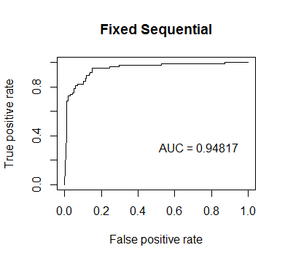
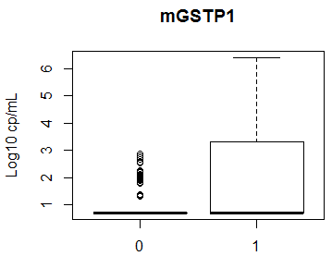
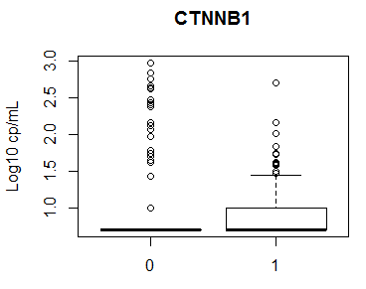
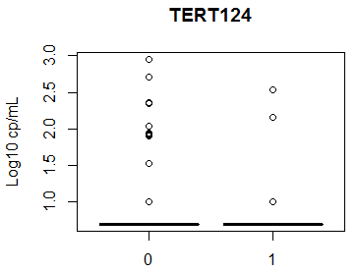
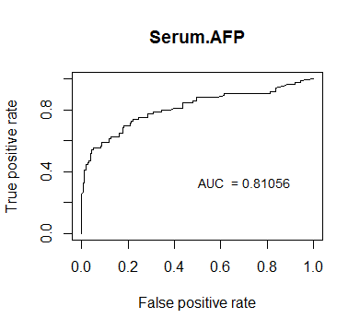
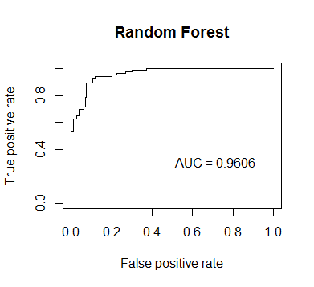
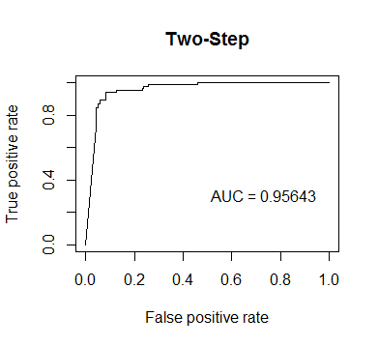
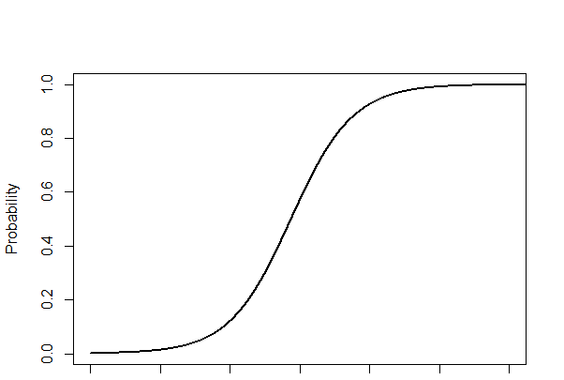
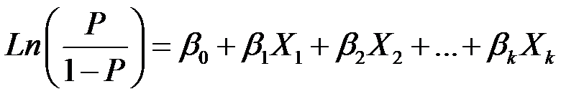
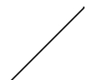

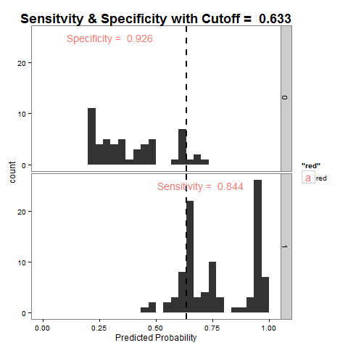
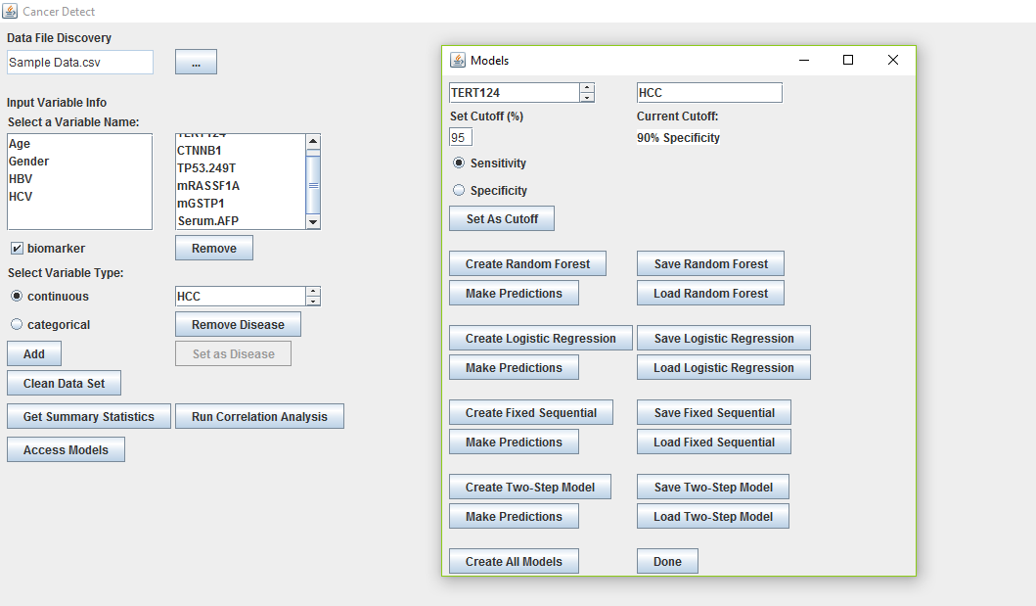
Abstract
Evaluating and Implementing
Novel Statistical Models
Blind Prediction Analysis
Hepatocellular carcinoma (HCC) is one of the fastest growing cancer with a low survival rate due in part to difficulties in early detection. Serum alpha fetoprotein (AFP), the current most-used screening test, has a sensitivity of only ~60%. This study applied random forest (RF) to HCC, proposed two new models (fixed sequential (FS) and two-step (TS)), and compared each to full logistic regression (FLR) as HCC screening tests that incorporate AFP with five genetic and epigenetic urine biomarkers. FS exploits the high specificity of AFP to create a novel, highly sensitive model similar to tree models by splitting data according to AFP first and then according to the predictions of FLR. RF has been demonstrated to be effective in detection of heterogeneous diseases, albeit not in HCC. TS is an improvement upon the FS model that combines FLR and RF. We that proposed RF and TS were the most accurate and robust models, and our results showed that this is true. We then implemented all four models in CancerDetect, a user-friendly Java tool that performs HCC diagnosis or biomarker evaluation. By translating the evaluated models to diagnosis, a 50% more sensitive HCC screening test was developed, which detect more HCC for imaging confirmation and save many lives.
Descriptive Statistics
For the Early Detection of Liver Cancer
p = 0.06169
p <0.0001
Study Outline
p <0.0001
p =0.07342
Preliminary Study (2014)
Goals:
Combine multiple biomarkers
Improve beyond AFP
Techniques and Methods:
4 biomarkers (AFP, mRASSF1A, TP53.249T, and mGSTP1)
Early dataset (N=166, 78 HCC)
Full Logistic Regression
Novel Fixed Sequential Model
Milestones:
Reached statistically significantly higher sensitivity with fixed sequential than logistic regression can
Extended Research (2015)
Goals:
Incorporate machine learning to improve sensitivity and specificity
Increase robustness
Techniques and Methods:
2 new biomarkers (TERT.124 and CTNNB1)
Larger open label training data set (N=188, 50 HCC) and bootstrapping analysis
New Application of Random Forest
Milestones:
Raised sensitivity at 90% specificity to 98% (95% CI:0.93-1) using random forest compared to 95% (95% CI:0.84-1) using fixed sequential
Found slightly increased robustness with random forest in bootstrapping procedure
p <0.0001
p = 0.1261
p = 1.000
p =1.000
Introduction
1 HCC 0 Non-HCC
Models Performance
Summary
Hepatocellular carcinoma (HCC) is:
One of the deadliest cancers, causing approximately 29,000 deaths in the U.S. annually with a 5 year survival rate of ~20%
One of the few cancers still rising in incidence in the U.S.
The 6th most common and 2nd deadliest cancer worldwide as of 2012
Trained to 90% specificity
McNemar’s test shows that FS is better than FLR (p = ) and RF (p = ).
This dataset came from a different source with many subjects from Asia.
There were no HCV infections, which is different from the open label training set.
However, the predictions are still relatively accurate, especially for FS and TS.
Helped our partners to meet their NCI milestones
 | Sensitivity | Specificity
AFP Alone | 0.593 | 0.986
FLR | 0.741 | 0.839
FS | 0.852 | 0.917
RF | 0.815 | 0.862
TS | 0.852 | 0.866
The current most-used screening test for HCC uses alpha-fetoprotein (AFP) which has a sensitivity of only ~50%
A more accurate and robust early detection method is needed. Urine biomarkers are convenient and diverse, making them useful
HCC’s high heterogeneity makes individual biomarkers less effective, so multivariate statistical models are vital tools in developing an effective screening test
Product Development and the Future (2016)
Goals:
Increase robustness
Translate research into practical use in a clinic or research lab
Prepare a system to apply research to other cancers as well
Techniques and Methods:
Unique Two Step Model
Improves performance by using the fixed sequential system to combine classical statistics and machine learning
Not as reliant on AFP as FS
Larger open label training data set (N=242, 83 HCC) with bootstrapping analysis
Blinded validation data set (N=247, 29 HCC)
Use of Java-R integration to create the user-friendly CancerDetect tool
Novelties
Proposal of two-step, which combines machine learning and regression modeling to enhance robustness and range of applicability
Development of a Java interface that allows end users to access basic statistical analyses and these models at their convenience
Results
Problem
Full Data Set
Bootstrapping
Summary
Criteria for a Successful HCC Screening Test:
High sensitivity to detect as many cases of HCC as possible
Reasonable specificity to reduce cost and stress
Robustness
Across subjects, in order to account for variation in cancer pathways from person to person
Across populations, in order to account for variation in etiology and demographics
Conveniently accessible
Univariate ROC
Model Evaluation Structure
Built on success of previous years through TS
TS performed the best of the four models in the bootstrapping analysis, especially at 95% sensitivity and 90% specificity
Translated most of the techniques used in this study into the user-friendly CancerDetect
In the blinded validation, FS and TS improve sensitivity to 85% compared to AFP’s 60%
(N=83)
AUC
Sensitivity
at 85% specificity
at 90% specificity (shown)
at 95% specificity
Specificity
at 90% sensitivity
at 95% sensitivity (shown)
at 99% sensitivity
(N=159)
Sensitivity and Specificity
p = 0.0372
p = 0.2162
p = 0.8774
p =0.0150
*Based on data available
a
b
Figure 1. All demographic values were analyzed between HCC and non-HCC subjects. Age was compared using t-test, and other variables were compared using chi-square test.
Results: The distributions of age and HCV infection were significantly different between HCC and non-HCC. The distributions of HBV infection and gender were not different.
Figure 3. ROC curves for all the individual biomarkers.
Results: All genetic and epigenetic urine biomarkers underperform compared to AFP alone.
Allows for evaluation of models with a constant value of sensitivity or specificity
95% sensitivity and 90% specificity set as baseline for a successful screening test
Conclusions
Hypothesis
Biomarker Summary
Multivariate ROC
AUC
By replacing AFP and logistic regression in the fixed sequential model, the two-step model will create a more robust and accurate method for early detection of hepatocellular carcinoma.
P < 0.0001
P < 0.0001
P < 0.0001
Figure 7a. Sensitivities of the models at a set specificity of 90% from 10,000 bootstrap runs.
Figure 7b. Specificities of the models at a set sensitivity of 95% from 10,000 bootstrap runs.
Results: Two-step performs best, while random forest also performs consistently well.
These trends hold true in different cutoffs of specificity (85%, 95%) and sensitivity (90%)
Based on the bootstrap, blinded validation, and boostrap results, the combination of TS and CancerDetect can serve as an HCC screening test that is 40% more sensitive than the current most-used technique
Because TS does not require AFP to be used like FS does, and because CancerDetect can function with and analyze most data, our research can be extended to other cancers as well
P < 0.0001
P < 0.0001
P = 0.9356
Figure 2. Biomarker values were compared between HCC and non-HCC subjects using box plots and Wilcoxon rank sum tests.
Results: All but TERT had significant differences in HCC vs. non-HCC.
Figure 6. The models were compared using bar graphs and t-tests on AUCs from 10,000 bootstrap runs.
Results: Random forest performed the best, two-step and fixed sequential were the next best.
Statistical Methodology
CancerDetect
Study Datasets
Discussion
Open Label Training Set
242 subjects: 83 HCC
Urine biomarkers: mRASSF1A, mGSTP1, TP53.249T, TERT.124, and CTNNB1
Data values on disease, gender, AFP, each biomarker, and previous viral infections
Blinded Validation Set
247 subjects: 29 HCC
Biomarker values: AFP, mRASSF1A, mGSTP1, and TP53249T
Rationale
Flowchart of CancerDetect
Complexity of R code requires computer knowledge to utilize the tool
CancerDetect’s point-and-click user interface runs R code scripts in the background
Allows technical use with minimum training
Normally, statisticians select which models to use
With CancerDetect, scientists can experiment with models themselves
Start
Inclusion of additional clinical variables (e.g. AST, ALT, smoking status, alcohol usage, etc)
Improvement of random forest by adding previous understanding of genetic pathways (perhaps implementing a weighting system)
Analysis of more data to further test the robustness of the models, particularly two-step and fixed sequential
Expansion into other cancers with biomarkers that are specific to other cancers
The ultimate goal of this study was to develop a method for the highly effective early detection of HCC and, if possible, other cancers. The products of this study fulfill that goal.
Multivariate Models
R Installed
False
Full Logistic Regression (FLR)
Random Forest (RF)
True
Run R Installation
Unload Package
Logit Transformation
Study Population
Methodology
Workspace Setup
Produces a linear predictor
Random Subsets
Java Swing
MigLayout
Engines enable preemption in a continuation-based construct
Scripting Engines load, compile, and run script code
RCaller Script Engine executes R code in Java environment
R-Java integration is relatively limited in the current computer science field, so the compatibility of R and Java was difficult to navigate
Data Selection
0.21
0.32
0.20
0.45
0.13
Creating Tool Interface
Variable Input
Controls
Cutoff
(adjustable)
Average PP
Predicted Probabilities (PP)
Clean Data
Cases
The predicted probability generated by the model is compared to a cutoff, thus producing sensitivity and specificity.
0.262
0.5
Load Models
Create Models
Correlation Analysis
Summary Statistics
HCC-negative
HCC-positive
Bibliography
Cutoff (adjustable)
Functionality
Predictions
Set Cutoff
Fixed Sequential (FS)
Two Step (TS)
Random Forest
Logistic Regression
Fixed Sequential
Two Step
Ferlay, J., Soerjomataram, I., Ervik, MDR, et al. GLOBOCAN 2012 v1.0, Cancer incidence and mortality worldwide: IARC Cancer base No. 11. Internet International Agency for Research on Cancer: Lyon, France; 2013.
Bruix, J., and Sherman, M. (2011). Management of hepatocellular carcinoma: an update. Hepatology, 53(3), 1020-2
Su, Y-H, Lin, S.Y., Song, W., and Jain, S. (2014). DNA markers in molecular diagnostics for hepatocellular carcinoma. Expert Rev. Mol. Diagn. 14(7), 803-817. doi:10.1586/14737159.2014.946908.
Jia, H-L, Ye, Q-H, Qin, L-X, et al (2007). Gene Expression Profiling Reveals Potential Biomarkers of Human Hepatocellular Carcinoma. Clin Cancer Res, 13, 1133-1139.
Wang, M., Long, R.E., Comunale, M.A., et al (2009). Novel Fucosylated Biomarkers for the Early Detection of Hepatocellular Carcinoma. Cancer Epidemiol Biomarkers Prev, 18, 1914-1921.
Laxman, B., Morris, D.S., Yu, J., et al (2008). A First-Generation Multiplex Biomarker Analysis of Urine for the Early Detection of Prostate Cancer. Cancer Res, 68, 645- 649.
Wang et al (2013). A comparison of statistical methods for the detection of hepatocellular carcinoma based on serum biomarkers and clinical variables. BMC Medical Genomics, 6(Suppl 3), S9
Breiman, L. (2001). Random forest. Machine Learning, 45, 5–32.
Wu, B., Abbott, T., Fishman, D., et al (2003). Comparison of statistical methods for classification of ovarian cancer using mass spectrometry data. Bioinformatics,19(13), 1636–1643.
Gupta, S., Sun, H., Yi, S., et al (2014). Molecular Markers of Carcinogenesis for Risk Stratification of Individuals with Colorectal Polyps: A Case-Control Study. Cancer Prev Res, 7, 1023-1034.
Liang, S-Y, Wu, S-W, Pu, T-H, et al (2014). An adaptive workflow coupled with Random Forest algorithm to identify intact N-glycopeptides detected from mass spectrometry. Bioinformatics, 30(13), 1908–1916.
Miyoshi, Y., Iwao, K., Nagasawa, Y., et al. (1998) Activation of the Beta-Catenin Gene in Primary Hepatocellular Carcinomas by Somatic Alterations Involving Exon 31. Cancer Res. 58, 2524-2527.
Nault, J-C, Zucman-Rossi, J. (2014). Genetics of hepatocellular carcinoma: The next generation. Journal of Hepatology, 60, 224–226.
Pinyol, R., Tovar, V., Llovet, J.M. (2014). TERT promoter mutations: Gatekeeper and driver of hepatocellular carcinoma. J Hepatol, http://dx.doi.org/10.1016/j.jhep.2014.05.028
Hosmer, D.W., and Lemeshow, S. (1989). Applied Logistic Regression. New York City: John Wiley & Sons, Inc. Print.
https://cran.r-project.org/web/packages/party/party.pdf
Heinze, G., and Schemper, M. (2002). A solution to the problem of separation in logistic regression, Statistics in Medicine, 21, 2409-2419.
Chen, C., Liaw, A., and Breiman, L. (2004). Using Random Forest to Learn Imbalanced Data. Department of Statistics, University of California, Berkeley. Technical report #666.
Xiao, G., Ma, S., Minna, J., and Xie, Y. (2014). Adaptive Prediction Model in Prospective Molecular Signature-Based Clinical Studies. Clin Cancer Res, 20, 531-539.
Libbrecht, M.W., Noble, W.S. (2015). Machine learning applications in genetics and genomics. Nature Reviews Genetics, 16, 321-332.
Saeys, Y., Inza, I., and Larranaga, P. (2007). A review of feature selection techniques in bioinformatics. Bioinformatics, 23(19), 2507–2517.
Pang, H., Lin, A., Holford, M., et al (2006). Pathway analysis using random forests classification and regression. Bioinformatics, 22(16), 2028-2036.
>20 ng/mL
AFP Positive
Possible HCC
>PP cutoff
FLR Positive
Possible HCC
Imported data is displayed intuitively
“Clean Data” identifies and removes data points with errors
“Summary Statistics” provides descriptive statistics of selected variables
“Create Models”
Models can be saved and loaded for quick re-accessibility
All results outputted to user-selected workspace (one easily accessible location)
Predictions produced by models output to .csv files
Predictions
Save Models
AFP
AFP Negative
Negative by Logistic Regression
FLR
FLR Negative
Negative by Random Forest
<20 ng/mL
<PP cutoff
Positive by Logistic Regression
Possible HCC
Positive by Random Forest
Possible HCC
Bootstrapping
242 subjects
210 training (200 unique subjects)
Impact
This process is repeated 10,000 times, and each model is trained and validated every time.
The numbers in the training and validation sets are subject to change in each run because of the replacement.
Scientists utilize tool’s intuitive layout with some training
Functionality includes both biomarker analysis and basic screening through predictions
Not limited to HCC, applicable to other diseases
42 validation

